Slide 1
HTML5 Game & Animation Development
Chapter 1 – Hello, HTML5 Canvas
by Yuehao Wang
GeekPie_@ShanghaiTech

Slide 2
What’s HTML5
In short, HTML5 is a brand new and more strict HTML standard which provides many useful functions and is supported by many platforms.

Slide 3
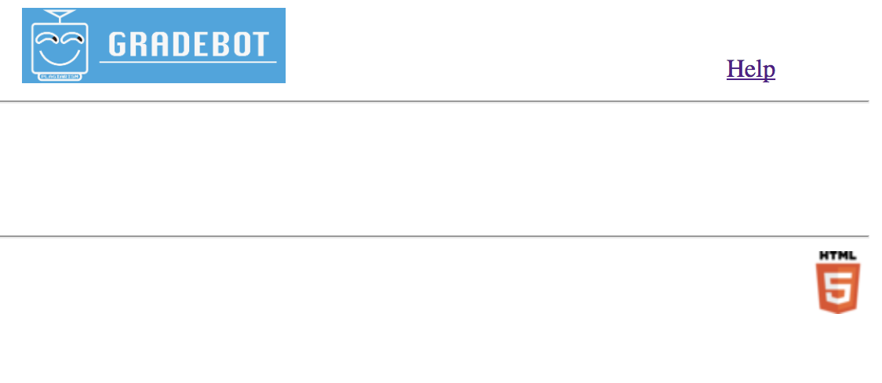
Who are using HTML5? Answer: Almost every main-stream website.

Slide 4
Attractive Features
HTML5 Canvas
Play video and audio
WebSocket
GPS
......

Slide 5
HTML5 Canvas
A simple but practical tool for rendering graphics and images.
Canvas is a kind of state machine.
Steps of using HTML5 canvas:
1. Write `<canvas>` in html.
2. Draw graphics and images on the canvas by simply calling canvas APIs in JavaScript.
Read ‘chapter1/shapes.html’ for details.

Slide 6
Canvas APIs
State machine
save(), restore()
Path
beginPath(), moveTo(x,y), lineTo(x,y), rect(x,y,w,h), closePath()...
Image
drawImage(img, x, y)
Renderering
fill(), stroke()...
Read ‘chapter1/{shapes.html , images.html, text.html, transformation.html, misc.html}’ to learn about these APIs.
APIs cheatsheet: http://www.w3school.com.cn/tags/html_ref_canvas.asp

Slide 7
Are these APIs competent to make a game?

Slide 8
Showcase – 0. Greeting Card
Scan it!

Slide 9
Showcase – 1. Flying Stone
Scan it!

Slide 10
Showcase – 2. Ink Spill
Scan it!

Slide 11
Excellent HTML5 game frameworks
Egret https://egret.com/
PixiJS http://www.pixijs.com/
ThreeJs https://threejs.org/
lufylegend.js http://lufylegend.com/lufylegend
CreateJs, Cocos2d-Js ...
However, we won’t use any game frameworks in this series of courses but to create our own simple game framework in the next class.

Slide 12
How to make a game?
Generally speaking, a game consists of three parts below:
Interaction: mouse, input, keyboard
Bgm and eff
Display: shapes, images, models, UI, CG

Slide 13
Interaction
Mouse
Keyboard
Data
Position
Color
Renderer
Change Position
Change color
Do rendering

Slide 14
A simple animation demo
A game needs a main loop where renderer clears canvas and repaints every element with new data.
Open ‘demo/simple_animation.html’ in a web browser and read the code.
To make every element easy-controlling, it’s recommended to use OOP in game development.

Slide 15
An OOP example
In a RPG, there might be a hero and some NPCs.
The hero and NPCs can move, attack and talk.
However, hero can buy props but NPCs can’t.
In addition, NPCs may have different looks.
We can implement some classes to fulfill these requirements:
Character
Hero
Npc
Npc1
Npc2
....

Slide 16
After this class...
You can draw various elements on an HTML5 canvas.
You may have the first impression of the HTML5 and game&animation development.
Practice: draw a Christmas tree on HTML5 canvas.
Next class: we’ll start to build a very simple game engine. (If you have a good idea about the engine’s name, please let me know)

